Slide 2
TensorFlow.js
Machine learning for JavaScript
Notes:
Hi, My name is Sandeep Gupta and I am the Product Manager of TensorFlow.js. This talk is about Machine Learning in JavaScript.
Now you may wonder - I am not a JavaScript developer, so why do I care.
Well, I will show you that machine learning in JavaScript enables some really powerful and amazing applications, and may be the right solution for your next machine learning use case.

Slide 3
Notes:
Earlier this year, Google released its first ever AI powered Google Doodle, in which users could synthesize a Bach style harmony using an ML model running in the browser. In just 3 days, more than 50 million people used it to create, save, and share their music.
A creative marketing team in Google has built a fun interactive experience where users are shown a zodiac symbol, and they try to match the shown animal with their hand shadow, making the character come to life.
Other teams are experimenting with ways of making web interfaces more accessible. In this example here called Creatability, people can control web interfaces with gesture, such as playing a keyboard with their face motion.

Slide 4
A library for Machine Learning in JavaScript
Use in the browser or with Node.js
Notes:
all of these have been made possible by TensorFlow.js, which is an open source library for machine learning in JavaScript. It can be used in the browser or server side with Node.js

Slide 5
TensorFlow.js
Multiple starting points for your needs
Run existing models
Pre-packaged JavaScript or Converted from Python
Retrain existing models
With transfer learning
Write models in JS
Train from scratch
Notes:
You can use TensorFlow.js in one of three ways: you can run a pretrained ML model in your application; you can customize a pretrained model by retraining it on your own data; or you can use the lower level ops API to write a new model from scratch directly in JavaScript

Slide 6
Build JS applications in minutes
Use ML with JavaScript (web, native, or server-side)
Notes:
There are many reasons why you may want to consider using TensorFlow.js: first, it is a JavaScript based API - so it means that all the JavaScript developers out there can now directly use machine learning in their applications. It is really easy to get started and be up and running.

Slide 7
Build JS applications in minutes
Use ML with JavaScript (web, native, or server-side)
<script src="https://cdn.jsdelivr.net/npm/@tensorflow/tfjs"></script>
<script src ="https://cdn.jsdelivr.net/npm/@tensorflow-models/body-pix”></script>
Notes:
With just a few lines of code, you can load the library, and load a model such as the body pix model here which does person segmentation in an image

Slide 8
Build JS applications in minutes
Use ML with JavaScript (web, native, or server-side)
<img src=”myimage.jpg”></img>
const net = await bodyPix.load();
const segmentation =
await net.estimatePersonSegmentation(image);
Notes:
you create an instance of the model, and call the estimate person Segmentation method on your selected image

Slide 9
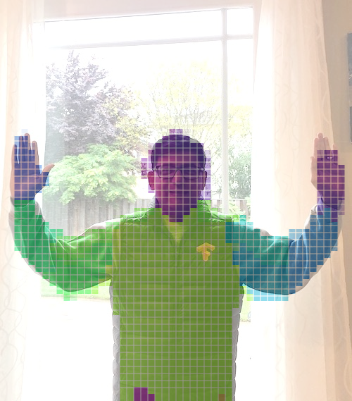
Build JS applications in minutes
Use ML with JavaScript (web, native, or server-side)
// Result
{
width: 480,
height: 640,
data: Uint8Array(307200) [0, 0, 1, ...]
}
// Built in rendering methods
bodyPix.drawPixelatedMask(...);
Notes:
and get back the result, as a JSON object which contains the segmentation mask, which can then use in your application code. That’s it - in just minutes you are using ML in your web application, without having to deal with tensors and optimizers and losses etc.

Slide 10
Client-side ML in Browser
Interactivity
No install
Privacy: Data stays client side
Fast performance through WebGL
Client
Server
Notes:
Using TensorFlow.js client side in the browser has many advantages.
You get all the benefits of the interactivity web as a platform. users don’t need to install anything, so your application becomes instantly deployable and shareable.
Another big benefit is that data stays client side, which has very important privacy implications, and also helps reduce latency and server costs.
And it supports GPU acceleration through WebGL for excellent performance.

Slide 11
Server-side with Node.js
Directly use TensorFlow SavedModels
Large npm package ecosystem
Maintain a single stack
Client
Server
Notes:
Many enterprises use Node.js. And TensorFlow.js can be used with Node.js. You can run any TensorFlow model through TensorFlow.js Node, and you get the benefit of the enormous ecosystem of Node packages. For enterprises where your entire backend and data operations are in Node, you can now do ML in the same stack.

Slide 12
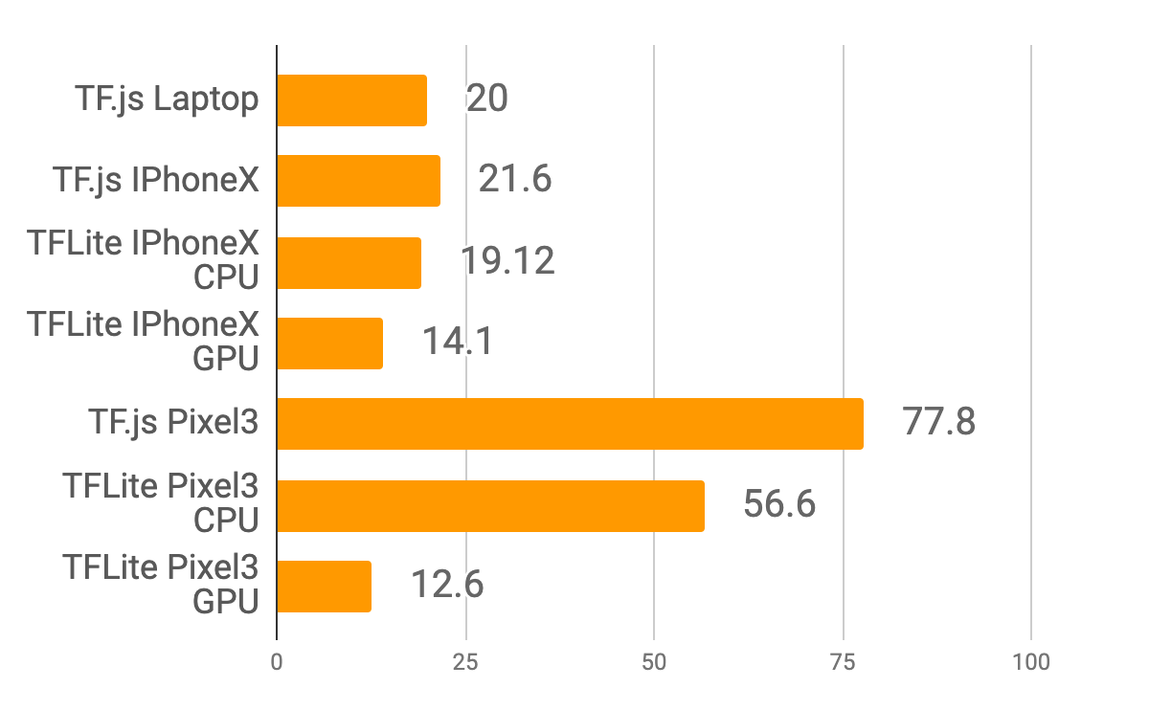
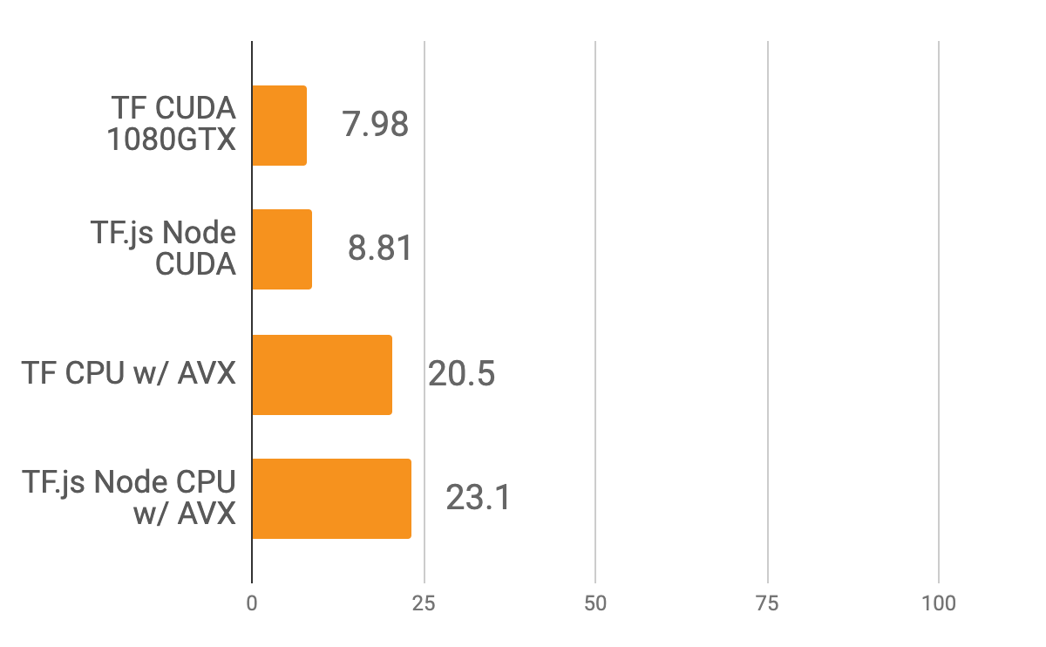
Performance
MobileNet v2 inference time in ms
Real time inference on mobile device
Server side parity with TensorFlow Python
Notes:
A natural question is - how fast is it? Here I am showing MobileNet v2 inference time benchmarking results. We get 20 ms inference time running on high end mobile devices, which means you are getting ~50 fps good enough for real time applications. We have room for improvements on Android devices and we are working on that.
And on server side, we have performance parity with Python based TensorFlow both on CPU and GPU.

Slide 13
Pre-built Models
JavaScript APIs for common ML tasks
Image Classification
Object Detection
Pose Detection
Speech Commands
Text Classification
npm install or use from our hosted scripts
Notes:
To help you get started, we have a collection of pre-trained ML models for common ML problems, such as image classification and object detection, detecting human pose, audio models for recognizing words and building speech command interfaces, and some text models for classification - sentiment and toxicity etc. It is really easy to use these with high level wrapped APIs from our hosted scripts or from our npm packages.

Slide 14
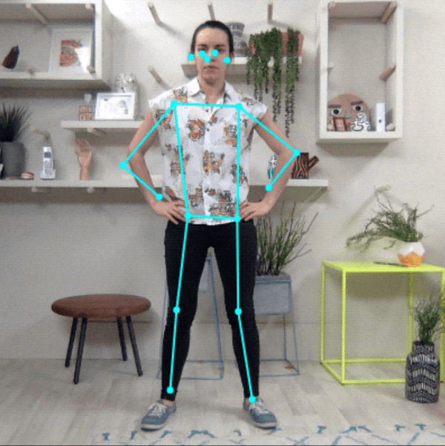
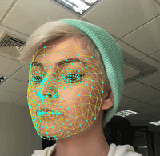
Building blocks for ML in Web Apps
Augmented Reality
Gesture-based interaction
Speech recognition
Accessible web apps
Sentiment analysis, abuse detection
Conversational AI
Web-page optimization
Notes:
Using these models as building blocks, applications can be built that enable accessibity, VR experiences such as virtual product tryon, conversational agents, etc

Slide 15
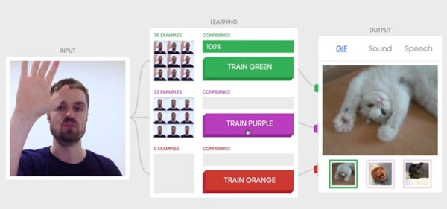
Training a custom model using transfer learning
teachablemachine.withgoogle.com
Notes:
These pretrained models are a great starting point. Often however, you need to customize the models on your own data. One way to do this is, again by using the power of TensorFlow.js running in the browser interactively. Let’s take a look at how easy this is.

Slide 16
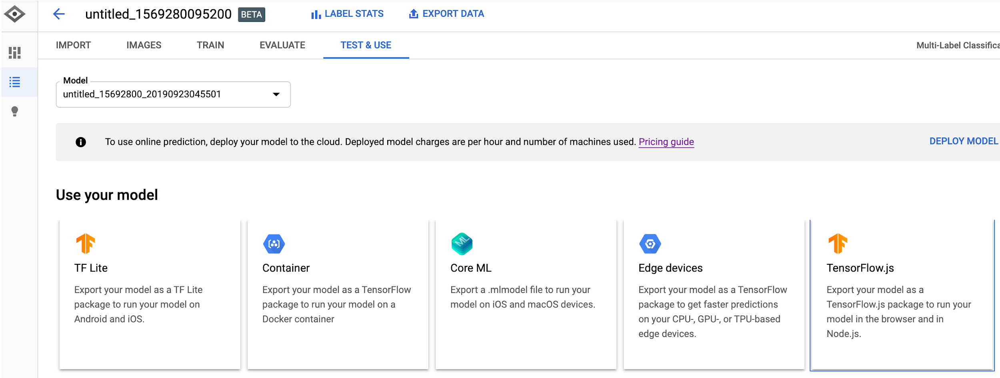
Announcing AutoML for TF.js
Train custom vision models automatically using GCP AutoML service
Notes:
Another way of creating custom models, is through the GCP AutoML service, and we have just announced support for TensorFlow.js in AutoML.
After training a custom model, you can now directly export a TensorFlow.js model and use in your application.

Slide 17
Training time
5 node-hrs
Accuracy ⇧
from 91% to 99%
Model Size ⇩
5x
Inference Speed ⇧
60%
Instantly deployed in a progressive web application
Notes:
One of our early testers, CVP Corporation, is building image classification models for the mining industry, and in just 5 node-hrs of training time, they got a model which was significantly more accurate, lighter weight and faster, and was smoothly deployed in a progressive web app !

Slide 18
Browser
Mobile
Server
Desktop
Notes:
In addition to models, another area we are pushing on is support for a variety of platforms where JavaScript is used. And we have recently added support for React Native!
React Native is a one of the most widely used JavaScript frameworks for building cross platform native apps, and now you can directly use TensorFlow.js from inside React Native with support for WebGL acceleration.

Slide 19
AR Virtual Product Try-on
Modiface Needs:
Client side for latency and privacy
10fps performance
<2 MB model size
Must support custom ops on diverse devices
With TensorFlow.js:
ModiFace virtual try-on app: 1.8MB。
GPU accelerated 25fps speed
Smallest fastest virtual try-on app so far
Notes:
So we have seen the capabilities of the library. Now let’s take a look at some use-cases. Modiface is an Augmented Reality technology company, based in Canada. They have used TensorFlow.js in the WeChat mini-program platform to build a beauty product virtual try on application for L’Oreal. Using TensorFlow.js, they were able to deploy a custom model meeting their model size and speed constraints for this application.

Slide 20
Notes:
To showcase how you can enable amazing user experiences with the power of TensorFlow.js, we built an application. Here, we are running a state of art machine learning model to track user’s lips and face movement, and using that to lipsync to a song, and score how well you do. And because there are many awesome JavaScript visualization libraries out there, we can add on some cool effects. Let’s take a look

Slide 21
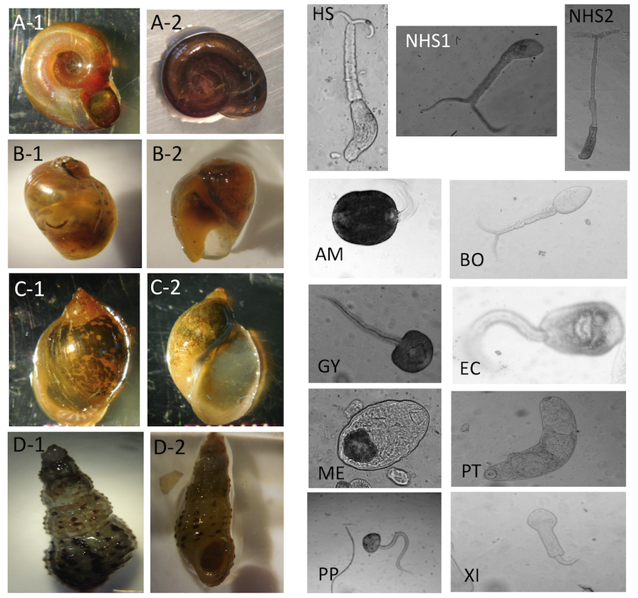
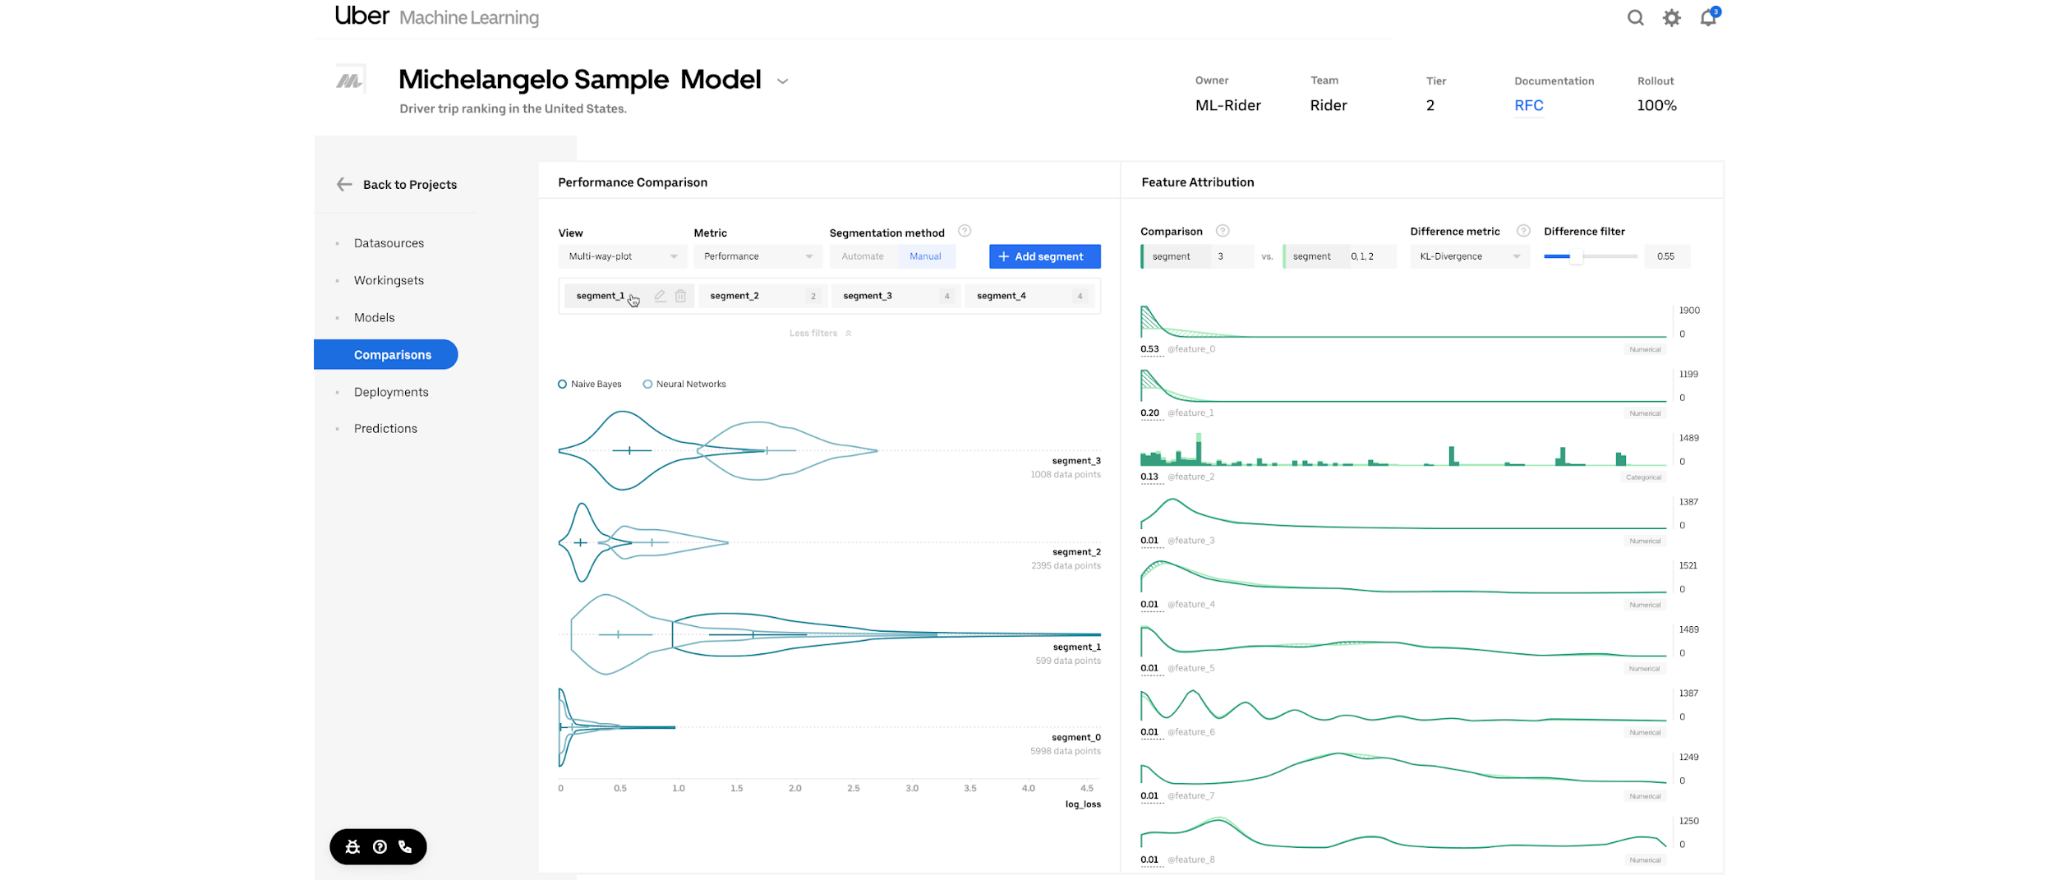
Real-world deployments
Uber
IBM Cognitive Group
Notes:
Companies are using TensorFlow.js for a variety of purposes, whether for internal tools for experimentation and visualization at Uber, privacy preserving client side application at AirBnb, and use in an offline mobile device for on the field use by IBM research.

Slide 22
Community
750K NPM downloads
10M CDN hits
face-api.js
handtrack.js
12K GitHub stars
200 contributors
hyperparameters
ml5
Notes:
Lastly I want to highlight that the success of the library is due to our amazing contributor and user community. The library continues to grow in usage and popularity, and we are really excited about the amazing libraries that the community is building on top of TensorFlow.js to extend its functionality and applications.

Slide 23
Learn More
tensorflow.org/js
Notes:
This was only a brief intro to TensorFlow.js. I hope I have been able to show you that if you have a web or Node.js ML need, TensorFlow.js is the solution for your needs! You can get lot more details on the platform in our in-depth session this afternoon, and also be sure to catch the awesome application talks from some of our users later today.

Slide 24
Joseph Paul Cohen, PhD
Notes:
With that, I will like to introduce Dr. Joseph Paul Cohen, to share with us a great use-case of TensorFlow.js and client-side ML.

Slide 25
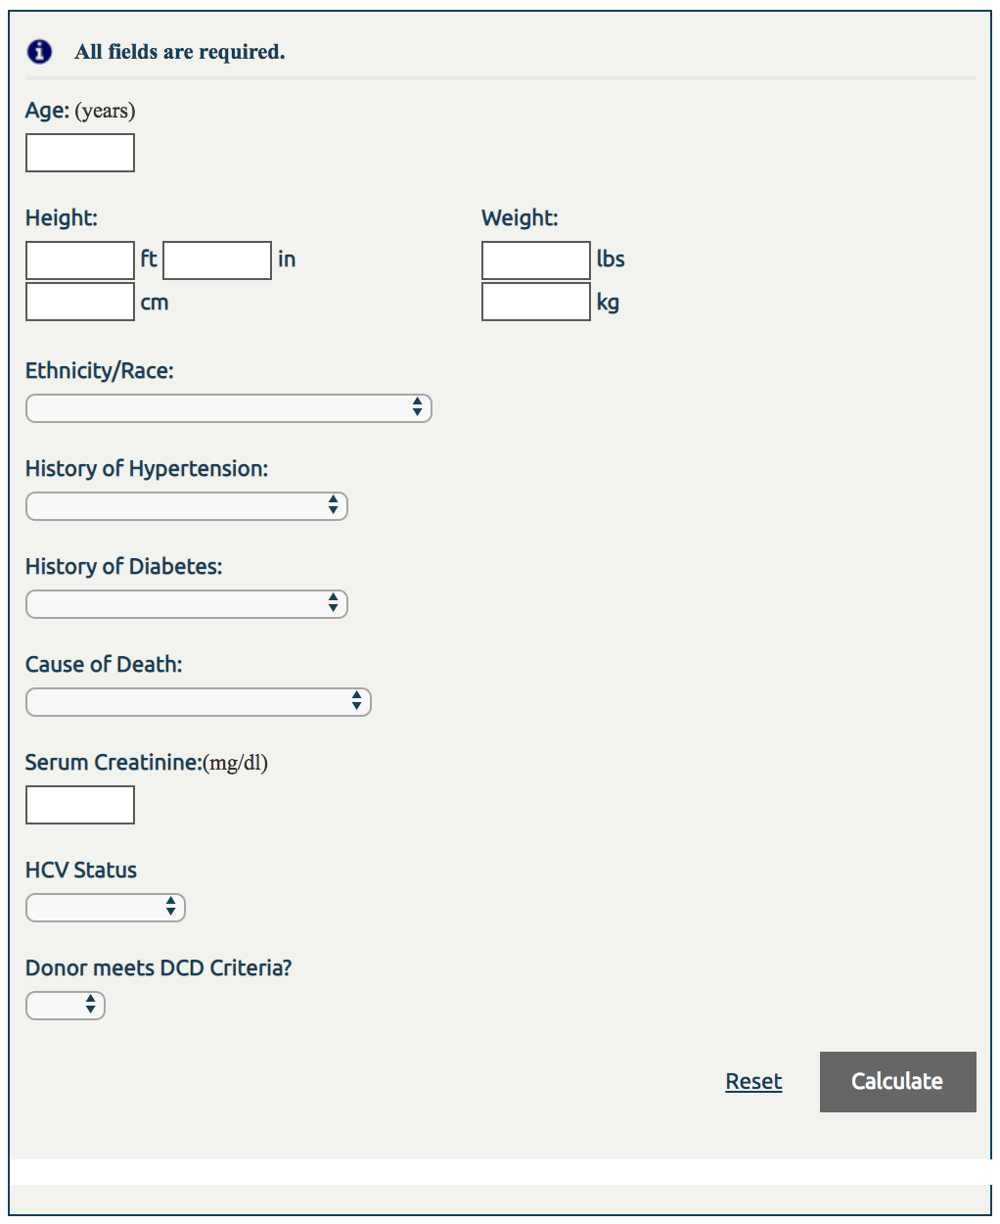
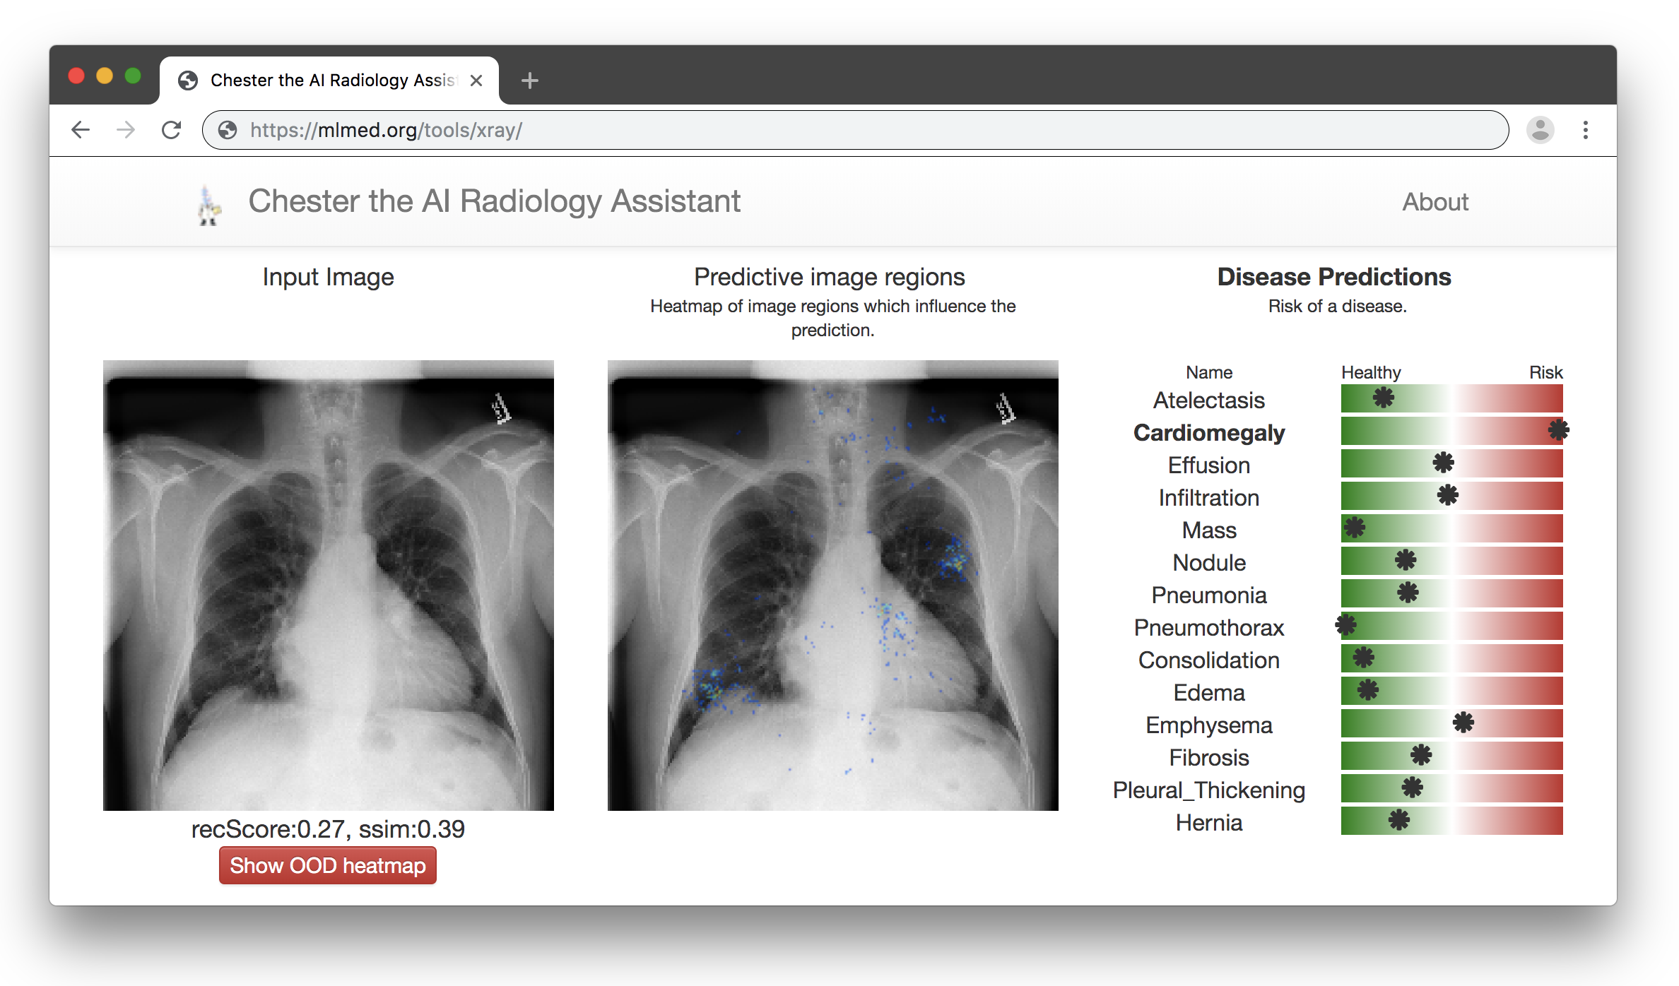
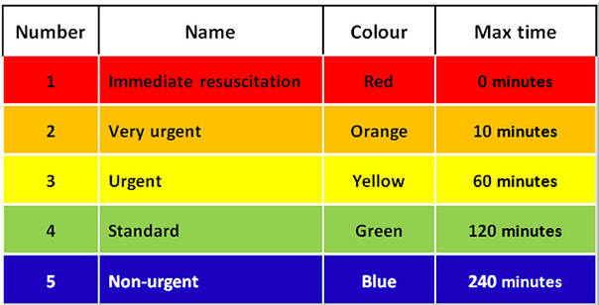
Kidney Donor Risk Index (KDRI)
[Feng 2006]
The Framingham Heart Study
Cardiovascular Disease Risk
[Online ~2018]
Emergency Room (Time limited human)
Rural Hospital (no radiologist nearby)
Chester: AI Radiology Assistant
[Cohen 2019]
Triage of cases by non-expert
Rare Diseases (still need more data)
Diagnostic pipeline
"Nice"
-Yann Lecun
[Cohen, Chester: A Web Delivered Locally Computed Chest X-Ray Disease Prediction System, 2019] https://arxiv.org/abs/1901.11210
Image credit: Keith Dreyer, Associate Professor of Radiology, Harvard Medical School
Notes:
How are people using models to influence diagnosis now?
Web tools have most impact. Accessible globally. Well defined input-output. (can be ambiguous if built into hospital system)

Slide 26
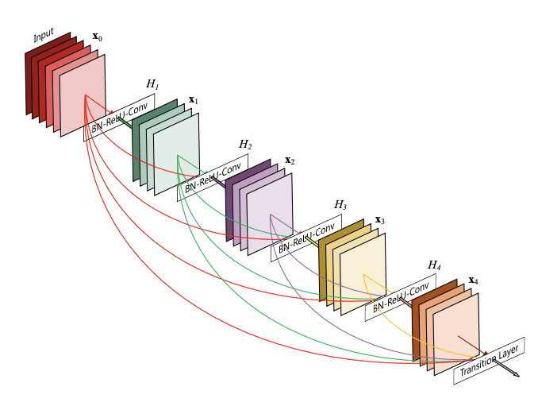
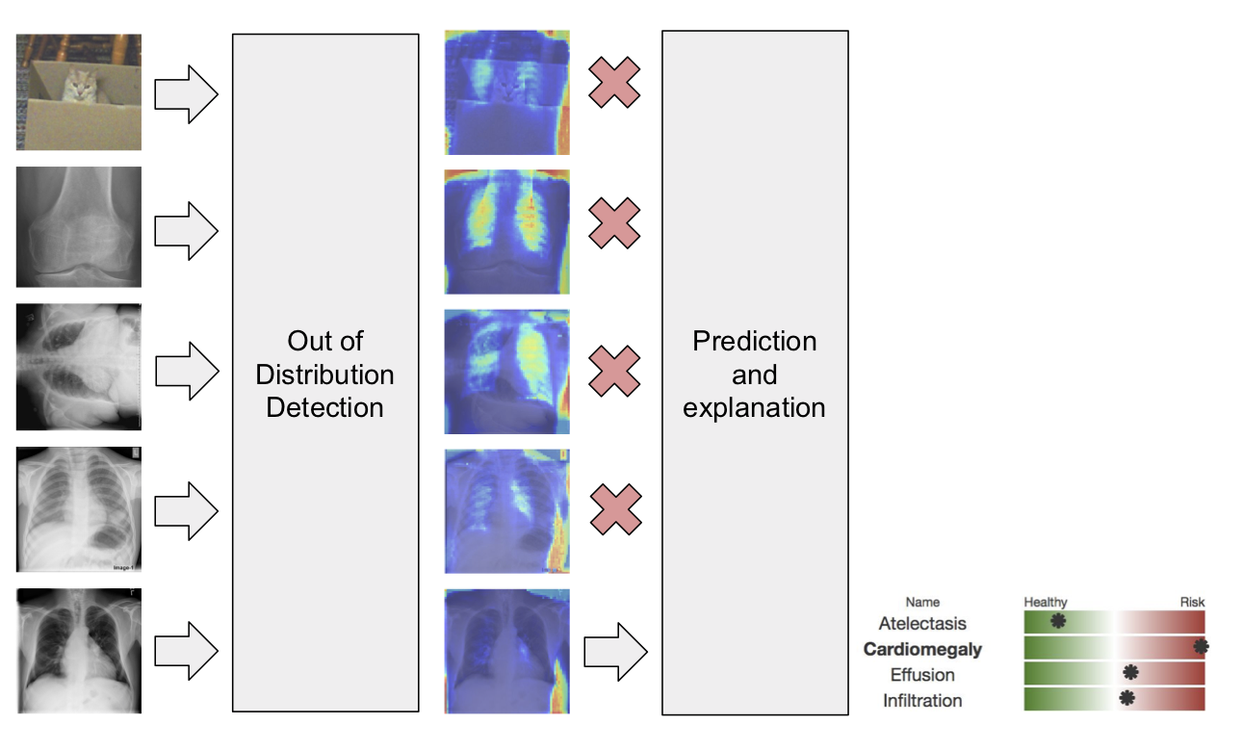
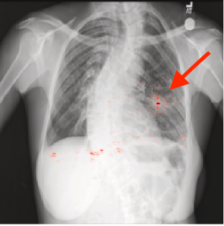
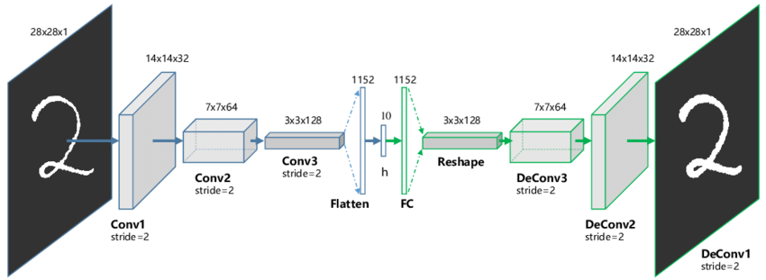
We need to prevent processing of out-of-distribution images.
We need to compute gradients in the browser!
We need to run a the SOTA
Chest X-ray DenseNet in the browser.
Compute inference in
~1 second?
(12 seconds for initial run)
Autoencoder with SSIM score!
Send special models or just autodiff in the browser!
[Cohen, Chester: A Web Delivered Locally Computed Chest X-Ray Disease Prediction System, 2019] https://arxiv.org/abs/1901.11210

